Slide 1
Eureka Analytics
Making data driven business decisions.
Barkha Bhojak
Dweep Kumarbhai Trivedi
Supicha Phadungsilp
Utkarsh Gera
Zeeshan Abid
Notes:
RBA - Restaurant Business Analytics
Eureka Analytics

Slide 2
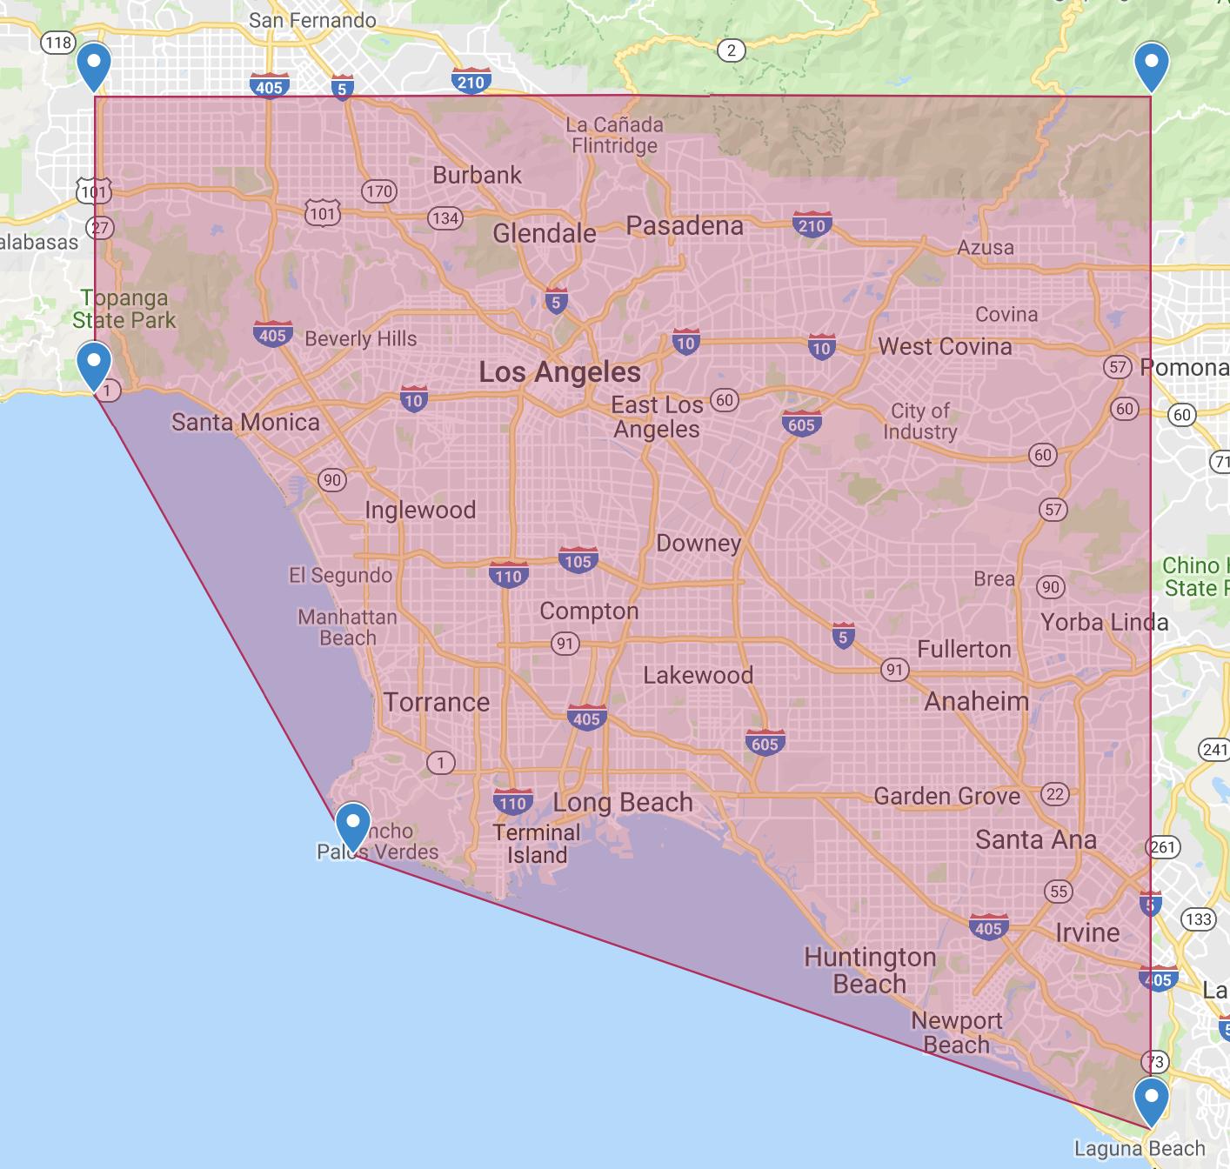
Problem Statement
Over the past few years, rise in number of social media platforms has led to generation of large amounts of user driven data. Businesses have now begun considering this data before taking strategic decisions which has paved the way for the application of data analytics. However, feasibility of this task remains limited due to the sheer volume of data being processed along with a large number of data sources.
For our purposes, we will be focusing on a specific type of business, i.e., restaurants based out of Los Angeles.
Given a location, we aim to predict a list of cuisines that are likely to receive a higher rating on Yelp.

Slide 3
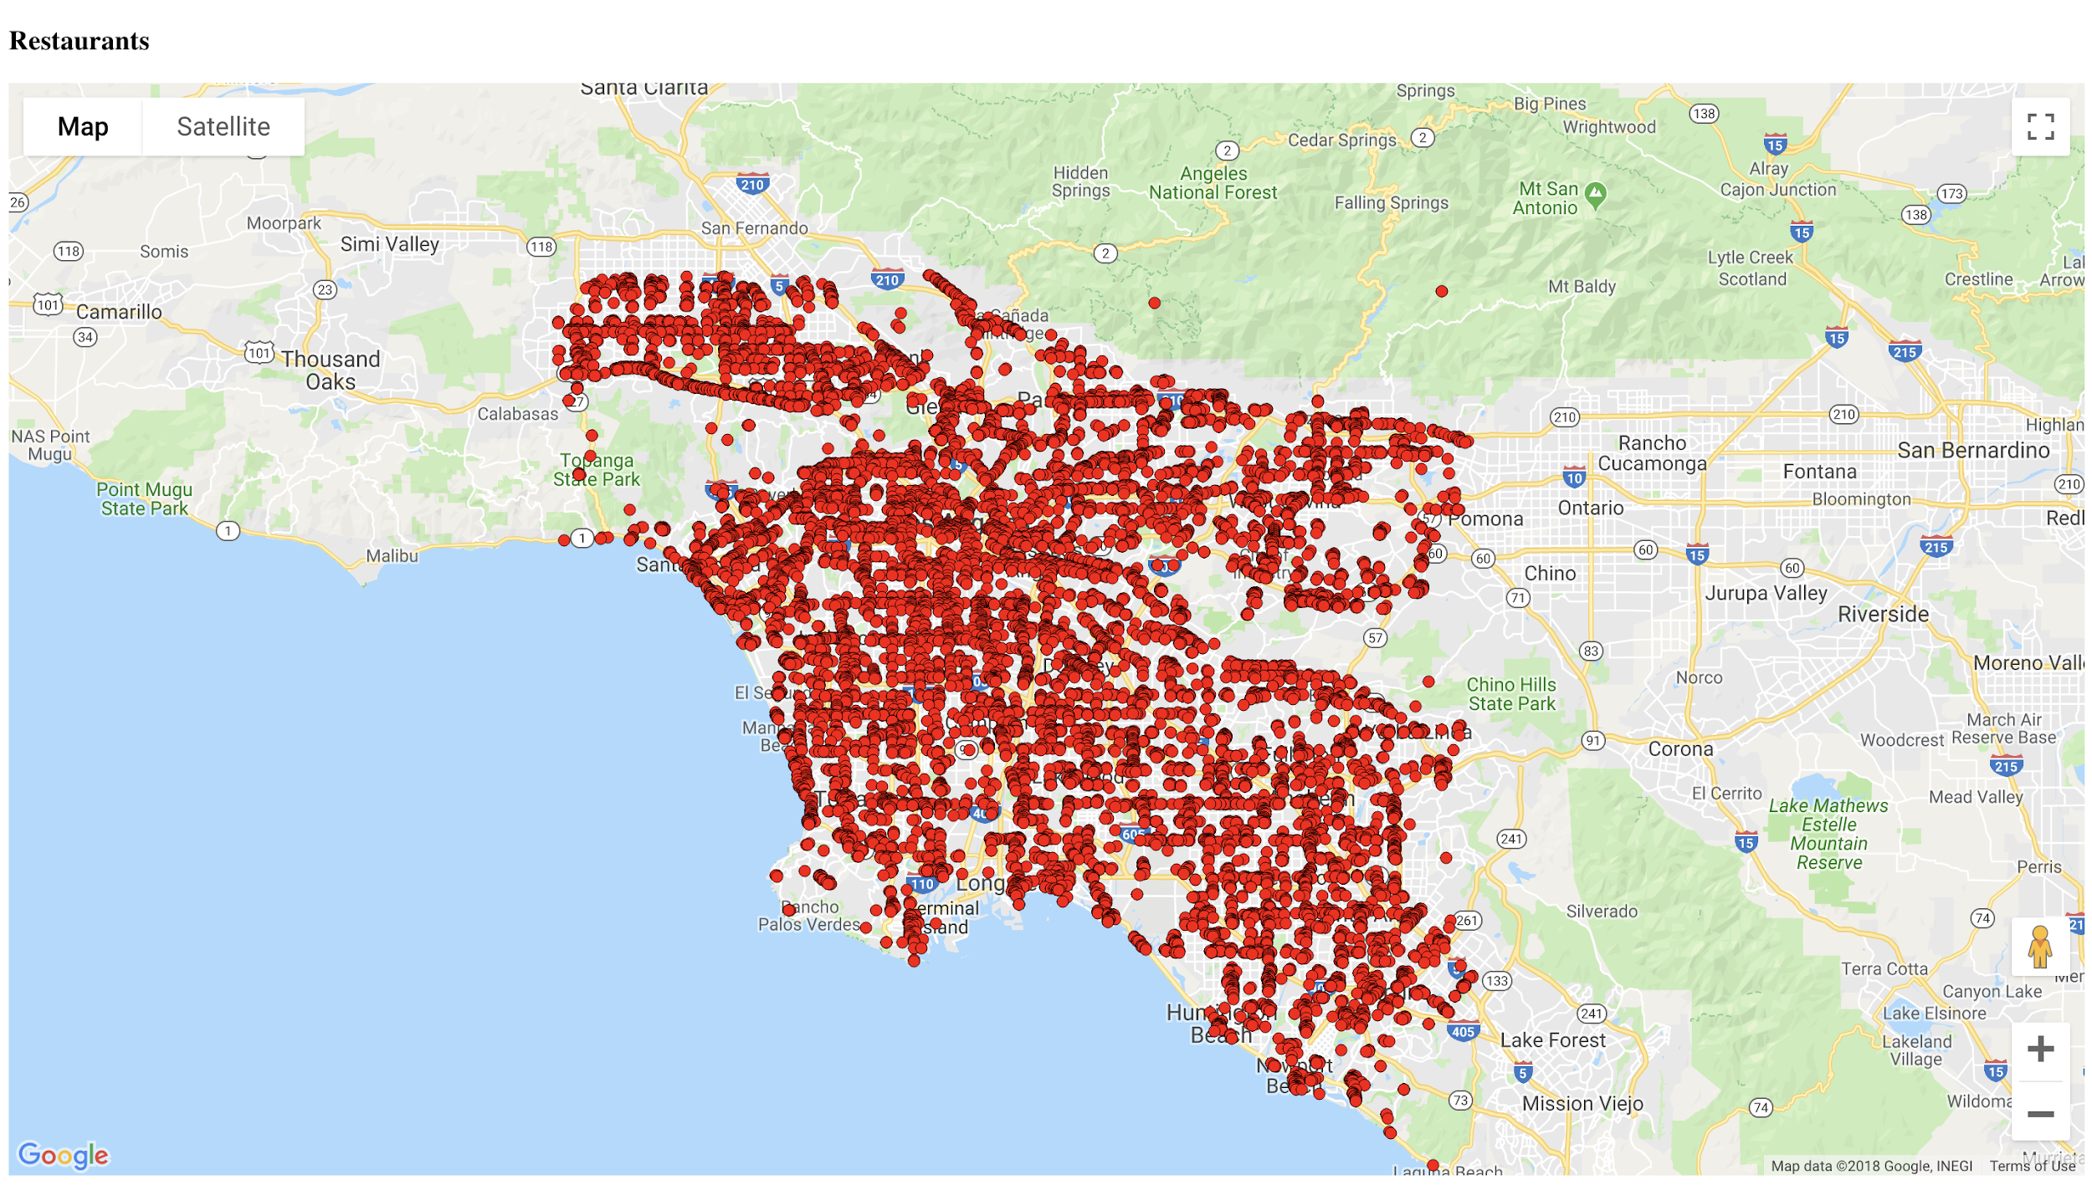
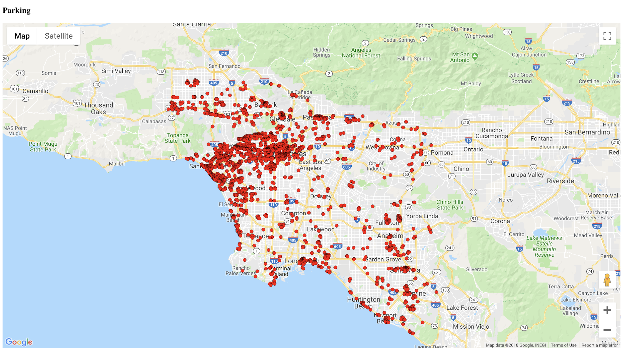


Datasets
Challenges faced
Google
15,515 restaurants
2,722 parking spots
Google Maps and Yelp
Los Angeles Crime Data
Los Angeles Census Data
Los Angeles parking meters
Bot detection
Timeout issues
Matching restaurants across Google and Yelp
Resource limitations
Yelp
10,083 restaurants

Slide 4
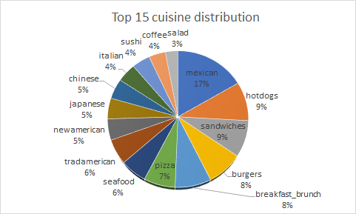
Feature Extractions
Google Maps and Yelp
Price
Ratings
Cuisines served at the restaurant
Average rating per cuisine of neighboring restaurants
Average price per cuisine of neighboring restaurants
Reviews
Popular times/Occupancy
Amenities
Los Angeles Crime Data
Total count of crime reported in a zip code
Los Angeles Census Data
Average population density of the zip code
Los Angeles parking meters
Number of parking meters near the location within a radius

Slide 5
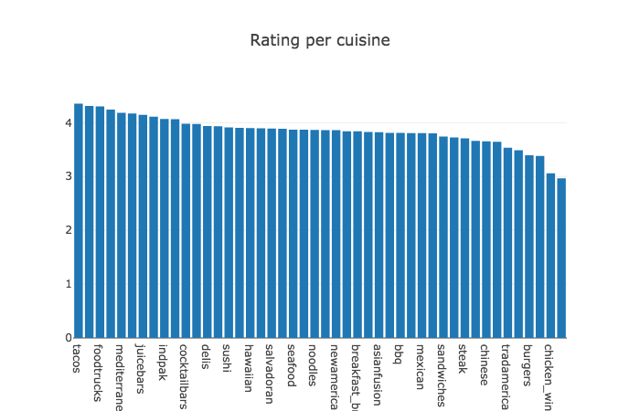
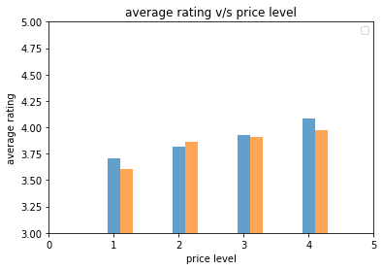
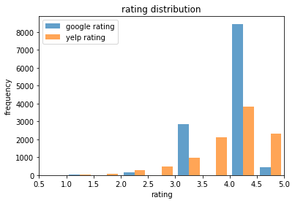
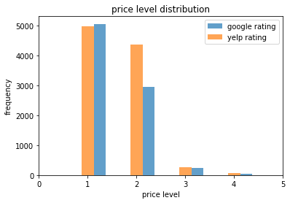
Analysis
Facts:
Most common cuisine: Mexican
Most correlated amenity: Street Parking
Most correlated cuisine: Hotdogs
Most correlated feature: Average rating of nearby restaurants of the same cuisine

Slide 6
Future Work
Handling class imbalance by dividing ratings in categories of equal instances.
Making use of reviews mined and popular times of the restaurant in order to better predict the success of a cuisine and providing a competitive advantage.
Including population density and average income as features.
Incorporating the total number of parking meters and lots in the neighbourhood of the restaurant.
Suggesting the price level of the restaurant given the cuisine and its location.
We have currently defined the success of a restaurant in terms of having higher ratings. We aim to explore the success of a restaurant in terms of review counts and number of visitors.

